Slide 1
Reading Group
Erasure Coding in Windows Azure Storage
2021/10/25
Presenter: Tianyang Niu

Slide 2
Outline
1
Background
2
Motivation
3
Design
4
Evaluation
3
5
Conclusion

Slide 3
Outline
1
Background
2
Motivation
3
Design
4
Evaluation
3
5
Conclusion

Slide 4
Background
Windows Azure Storage (WAS)
a scalable cloud storage system
Blobs , Tables , Queues , and Drives

Slide 5
Background
appended to the end of active extents
replicated three times by the underlying stream layer
reaching a certain size extents are sealed
erasure-coded
Delete 3 full copies

Slide 6
Outline
1
Background
2
Motivation
3
Design
4
Evaluation
3
5
Conclusion

Slide 7
Motivation
reduce the cost of storage
reduce the cost of storage over 50%
less hardware
reduces our data center footprint by ½
power savings from running 1/2 the hardware

Slide 8
Motivation
reduce the cost of storage
reduce the cost of storage over 50%
less hardware
reduces our data center footprint by ½
power savings from running 1/2 the hardware

Slide 9
Motivation
Challenge
Reconstruction
a lost or offline data fragment
hot storage nodes
(12, 4)
12 fragments
LRC
reduces the network overhead and number of I/Os
reduces the time

Slide 10
Outline
1
Background
2
Motivation
3
Design
4
Evaluation
3
5
Conclusion

Slide 11
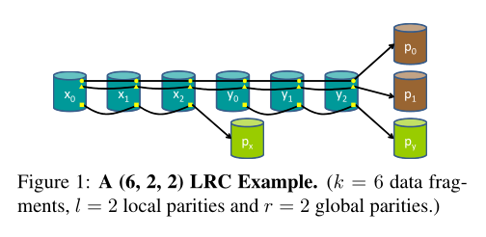
Design
LRC
r+1
86% of all the four failures

Slide 12
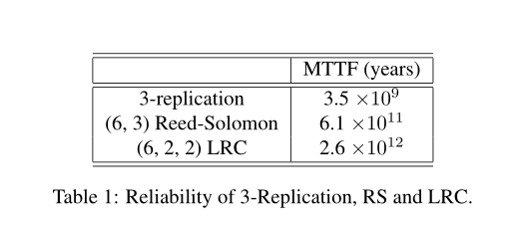
Design
Reliability Model

Slide 13
Implementation
WAS architecture
front-end layer
partitioned object layer
stream replication layer

Slide 14
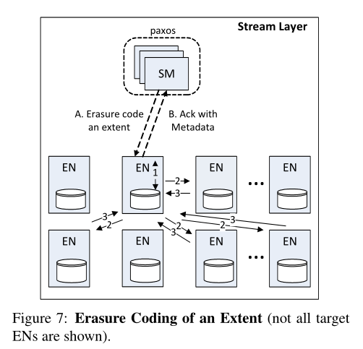
Implementation
Stream Layer Architecture
Stream Managers (SM)
Extent Nodes (EN)
Extent(replicated)
block(CRC)

Slide 15
Implementation
Erasure Coding in the Stream Layer
Asynchronous
off the critical path
SM periodically scans
schedules a subset
stream policies and system load

Slide 16
Implementation
Erasure Coding in the Stream Layer
SM creates fragments on a set of Ens
SM designates one of the Ens as the coordinator

Slide 17
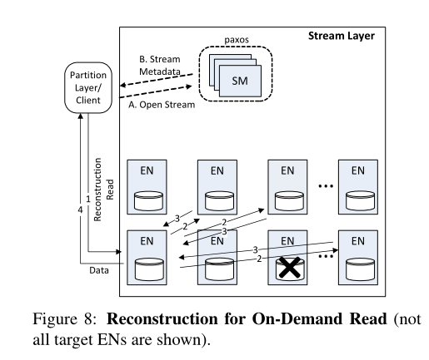
Implementation
Erasure Coding in the Stream Layer
reconstruction

Slide 18
Implementation
Using Local Reconstruction Codes in WAS
Placement
Load
reliability
x1
x2
x3
x4
x5
x6
Px
P1
P2
y1
y2
y3
y4
y5
y6
Py

Slide 19
Implementation
Designing for Erasure Coding
Scheduling of Various I/O Types
EN keeps track of its load at the network port
SM keeps track of data replication load

Slide 20
Implementation
Designing for Erasure Coding
Reconstruction Read-ahead and Caching
blocks (up to 5MB)
read-ahead data is cached in memory

Slide 21
Implementation
Designing for Erasure Coding
Arithmetic for Erasure Coding
pre-computing
using addition and multiplication tables
a transformation
XOR operations

Slide 22
Outline
1
Background
2
Motivation
3
Design & Implementation
4
Evaluation
3
5
Conclusion

Slide 23
Evaluation
size of I/O
Small I/O (4KB to64KB range)
large I/Os (4MB)
LRC (12, 2, 2) VS RS (12,4)
loaded
Lightly
Heavily
1Gbps

Slide 24
Evaluation
Small I/O
latency
number of I/Os taken

Slide 25
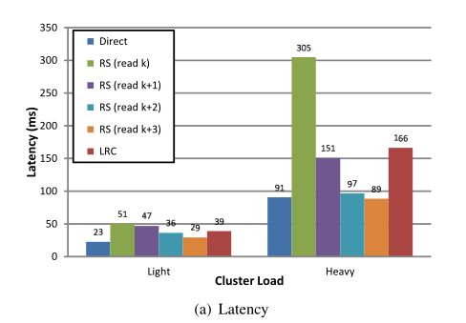
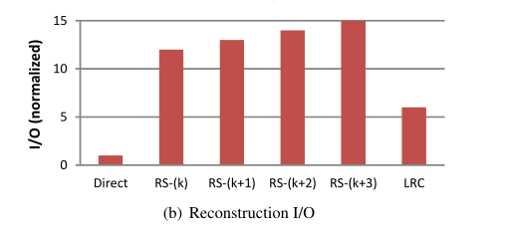
Evaluation
Small I/O

Slide 26
Evaluation
Large I/Os
latency
bandwidth consumption

Slide 27
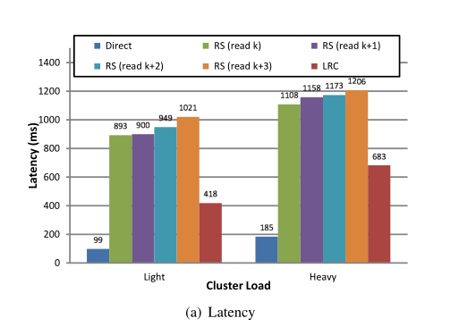
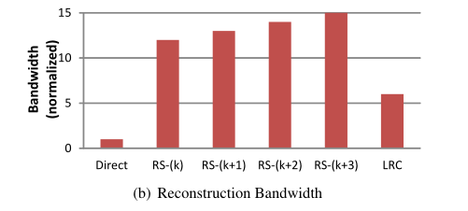
Evaluation
Large I/Os

Slide 28
Evaluation
Decoding Latency
4KB fragments
13.2us for Reed-Solomon
7.12us for LRC

Slide 29
Outline
1
Background
2
Motivation
3
Design
4
Evaluation
3
5
Conclusion

Slide 30
Conclution
storage overhead
1.33x
fast reconstruction
LRC VS RS
saves significant I/Os and bandwidth
comparable latency for small I/Os
better latency for large I/Os

Slide 31
THANK YOU

